Slide 1
Oracle Purchasing Tracking Implementation for the Logistics Industry

Slide 2
MEET THE TEAM
NAME | STUDENT ID
Nada Ashraf | 21048301
Mohanad Mahmoud | 21034016
Mahmoud Adel | 21004041
Ahmed Abd El-alim | 21041887
Mohamed Gamal | 21035946
Emad Hafez | 21014801

Slide 3
AGENDA
OBJECTIVE 1
SCOPE OF WORK 2
PROBLEM STATEMENT 3
PROPOSED SOLUTION 4
SYSTEM IMPLEMENTATION 5

Slide 4
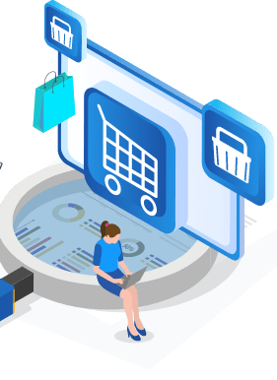
OBJECTIVE: The objective of this project is to implement Oracle Purchasing Tracking in the logistics industry, enhancing the efficiency and transparency of purchasing processes by providing real-time tracking of procurement activities.

Slide 5

Scope of Work:
o Analyze the current purchasing processes and challenges within the logistics industry.
O configure Oracle purchasing tracking to enable real-time monitoring of Purchase Orders and deliveries.
O integrate the solution with other modules such as inventory and supply chain Management.
O test and optimize the system to ensure full functionality and user adoption.
O provide training materials and documentation for end-users.

Slide 6

Problem Statement
In the logistics industry, purchasing processes often suffer from inefficiencies due to a lack of real-time tracking and visibility.
This results in delays, poor supplier collaboration, and inaccurate inventory levels.
The project aims to solve these challenges by implementing Oracle Purchasing Tracking to optimize procurement activities and provide better oversight.

Slide 7
Proposed Solution
The proposed solution is to implement Oracle purchasing tracking to provide end-to-end visibility of purchase orders, from when they are placed until delivery is completed. This will
Allow the logistics industry to streamline purchasing processes, improve supplier relationships,
Ensure timely procurement of essential materials and services.

Slide 8
System implementation

Slide 9
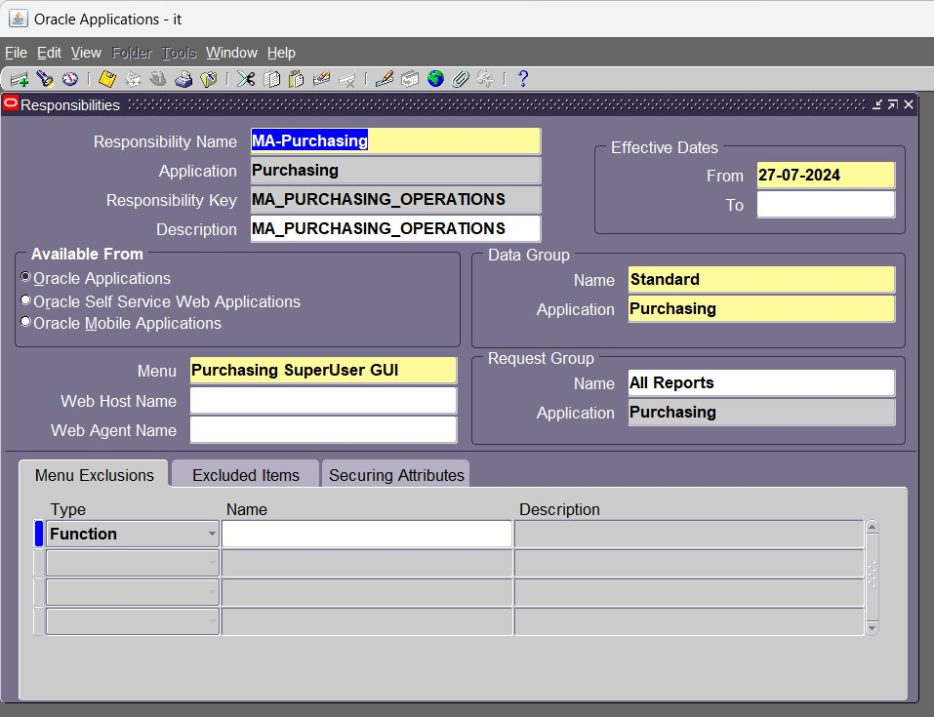
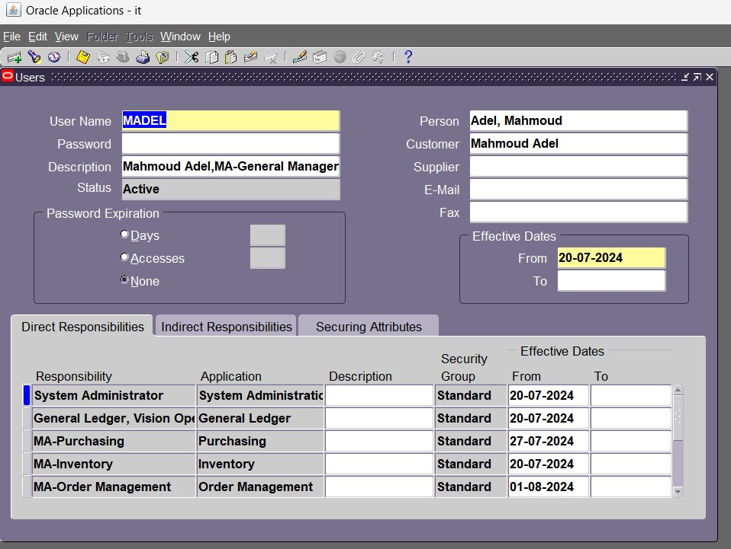

Slide 10
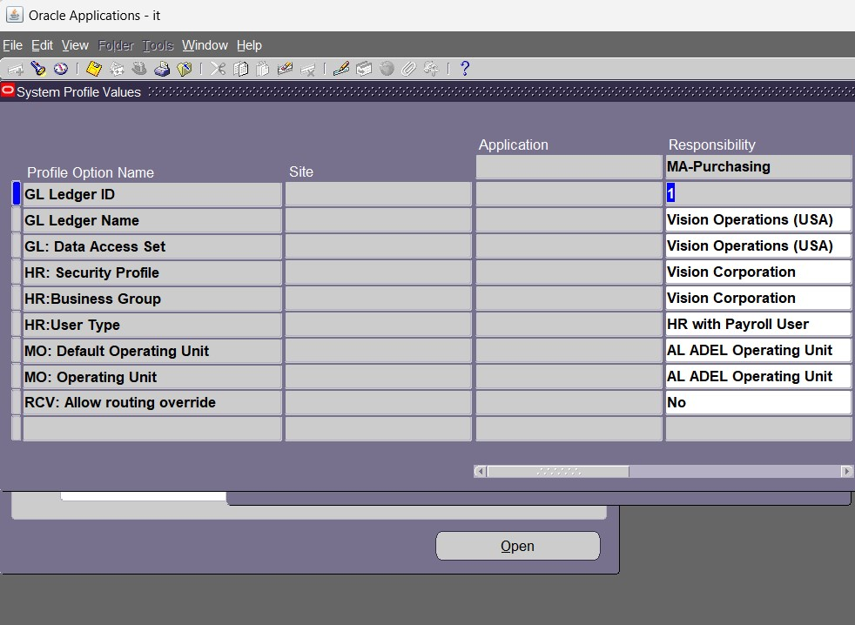
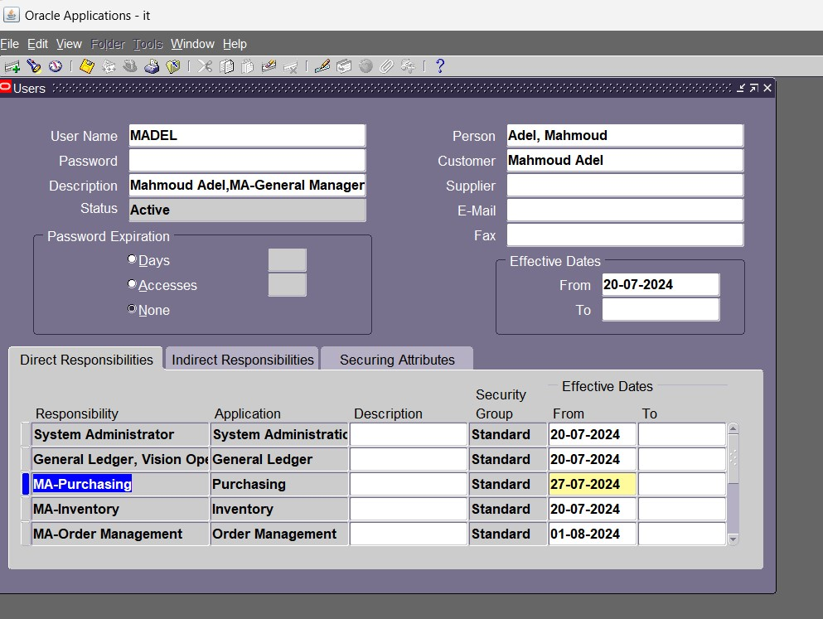

Slide 11
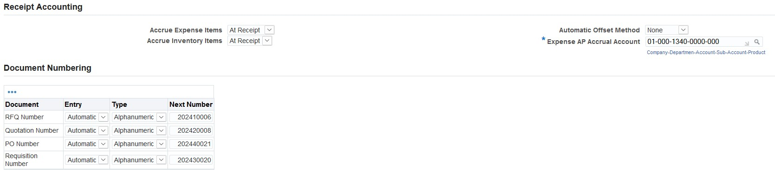
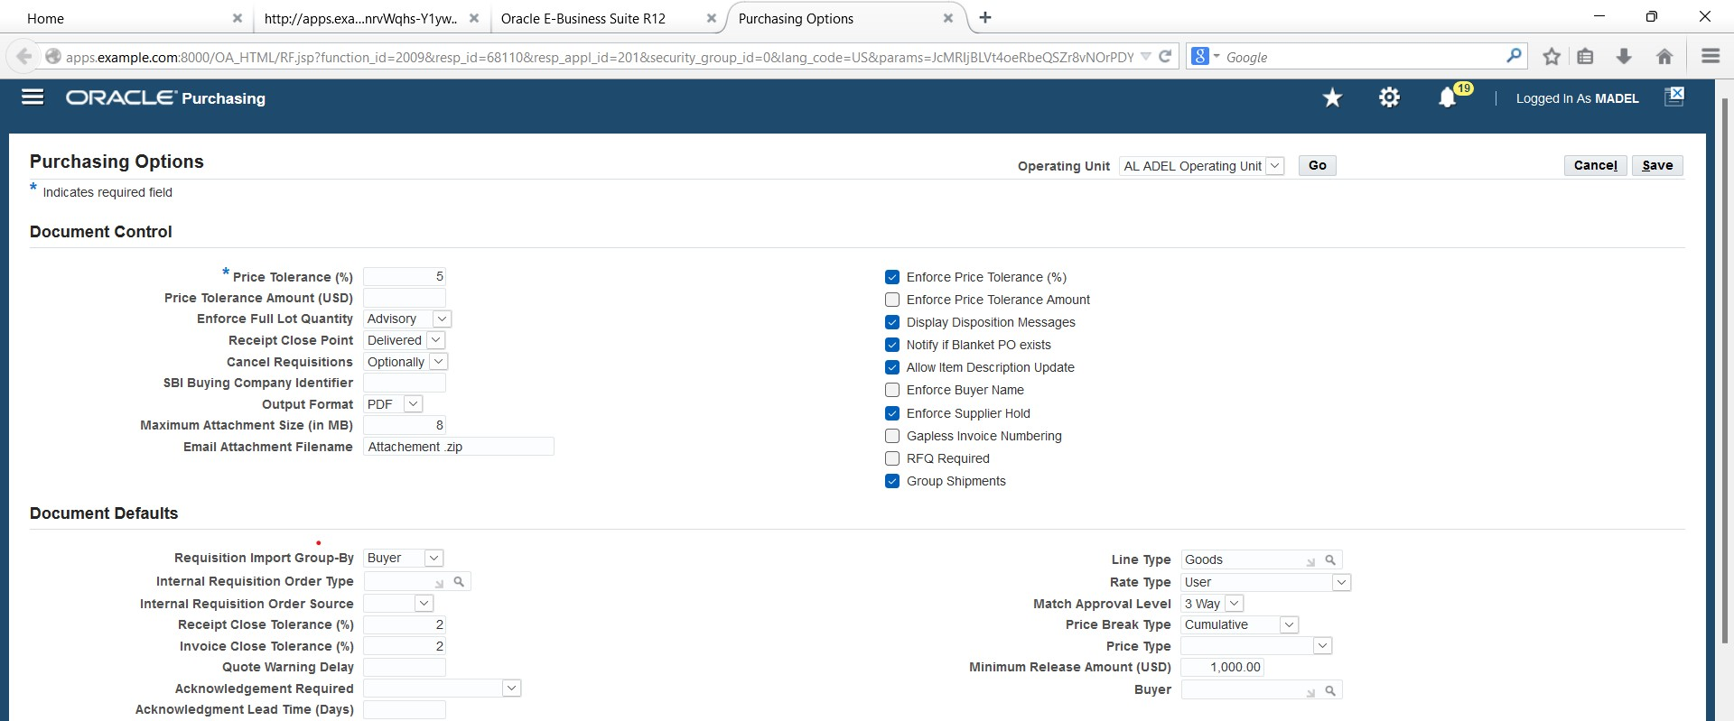

Slide 12
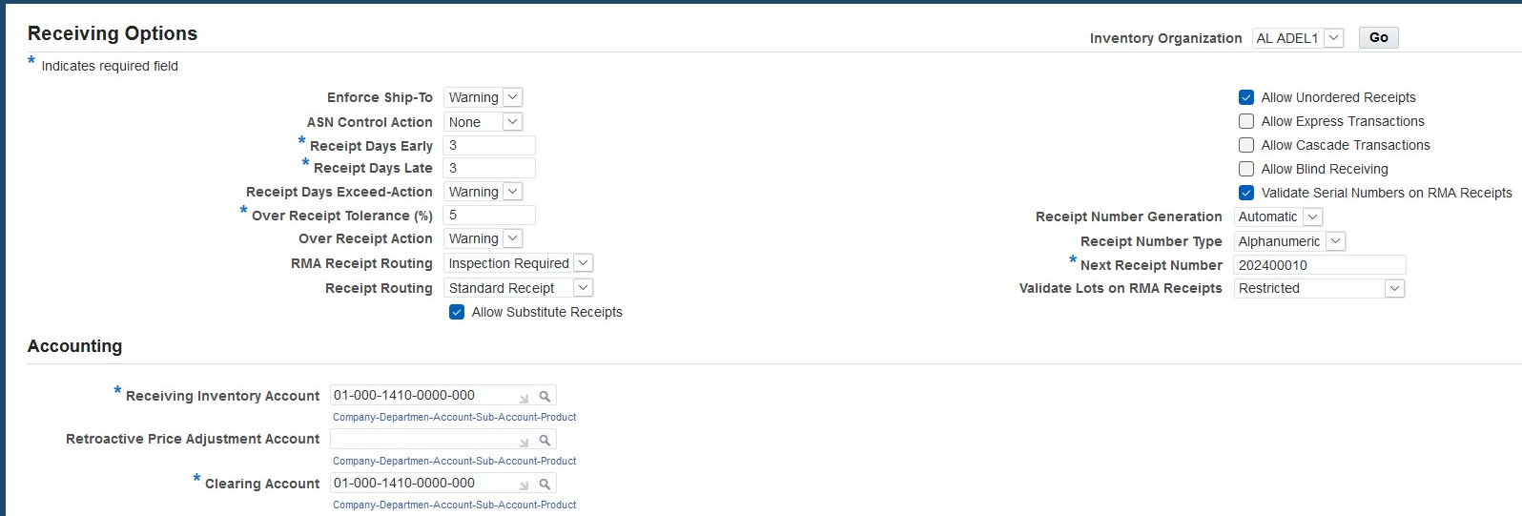
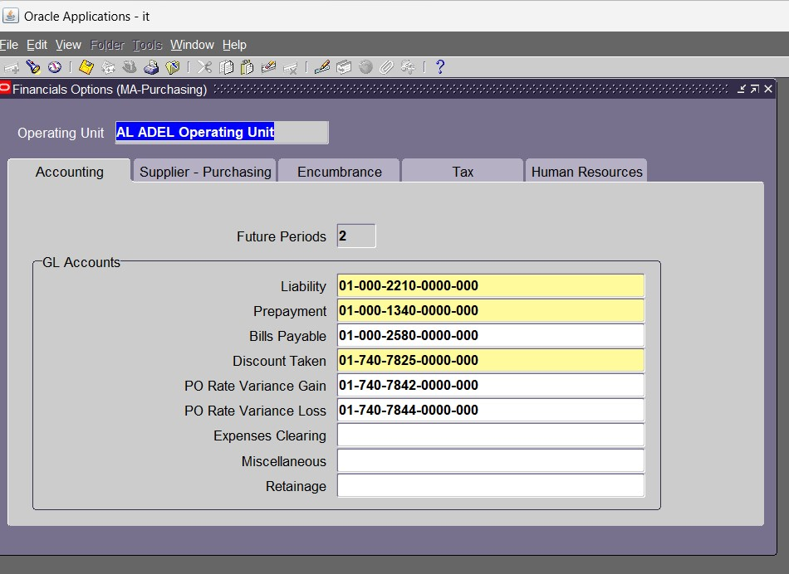
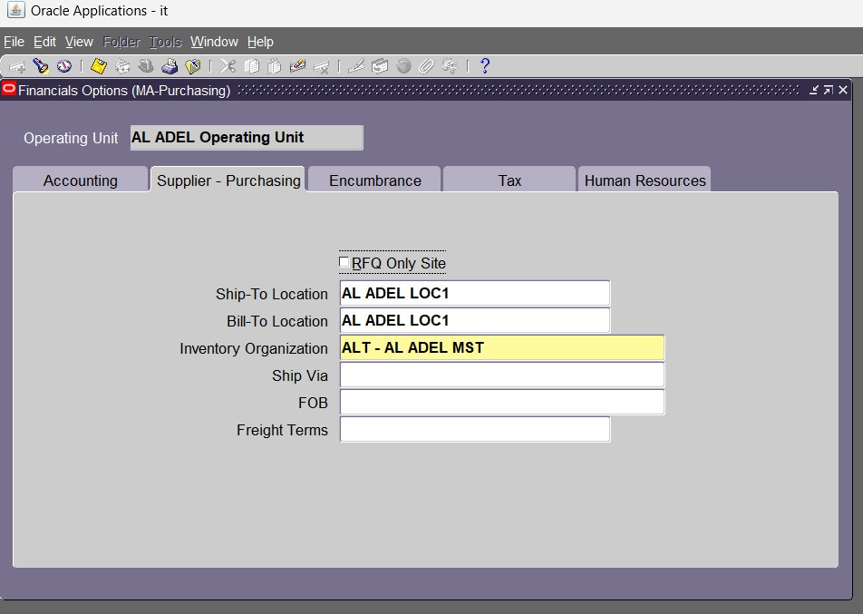

Slide 13
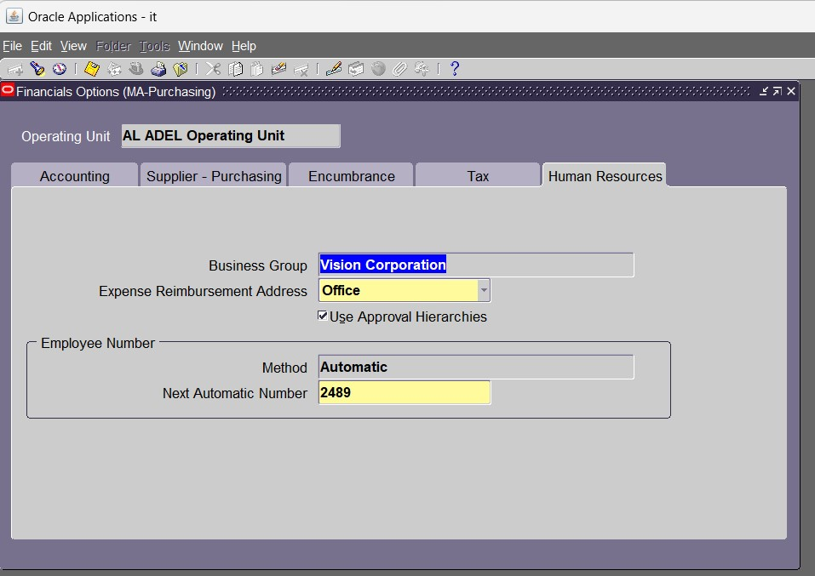
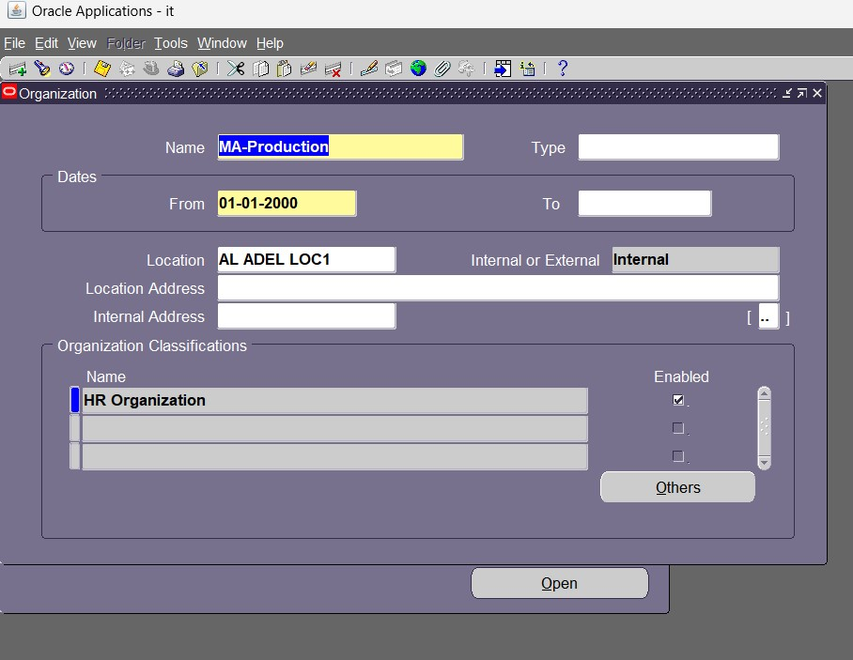

Slide 14
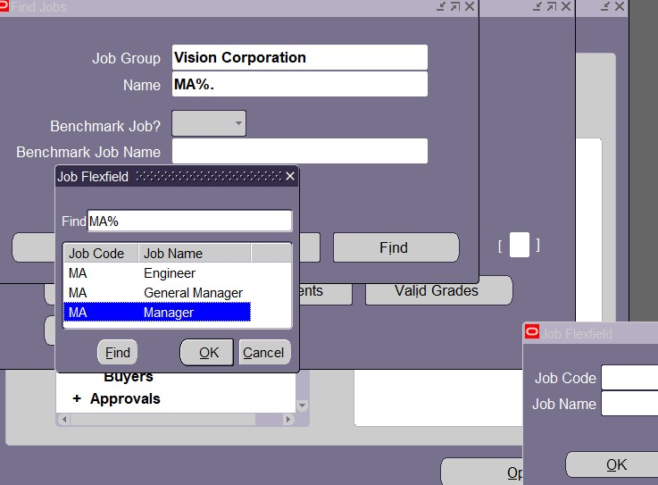
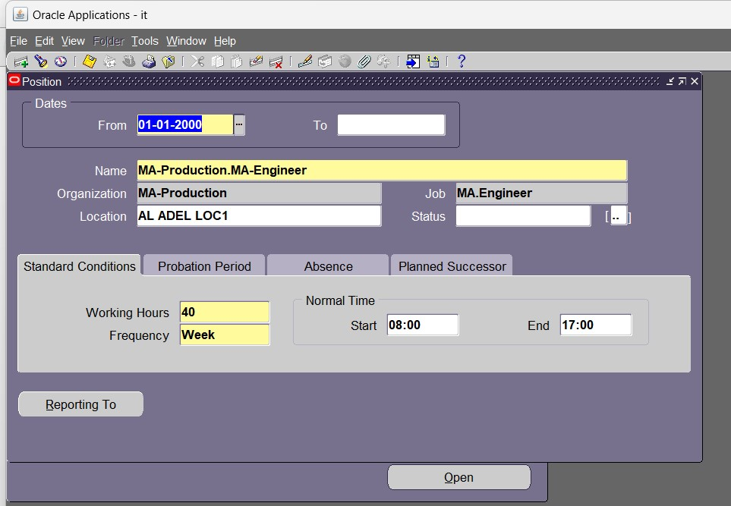

Slide 15
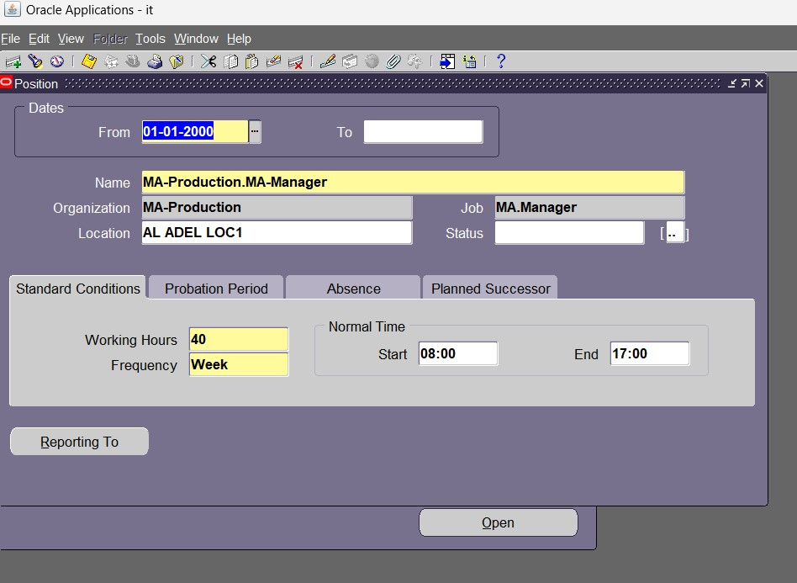
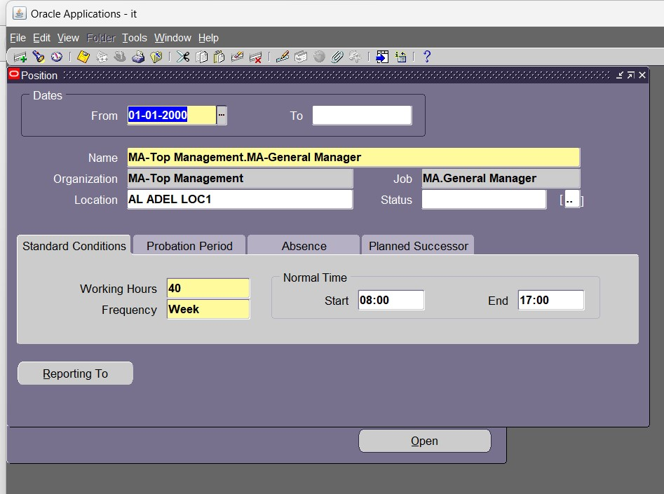

Slide 16
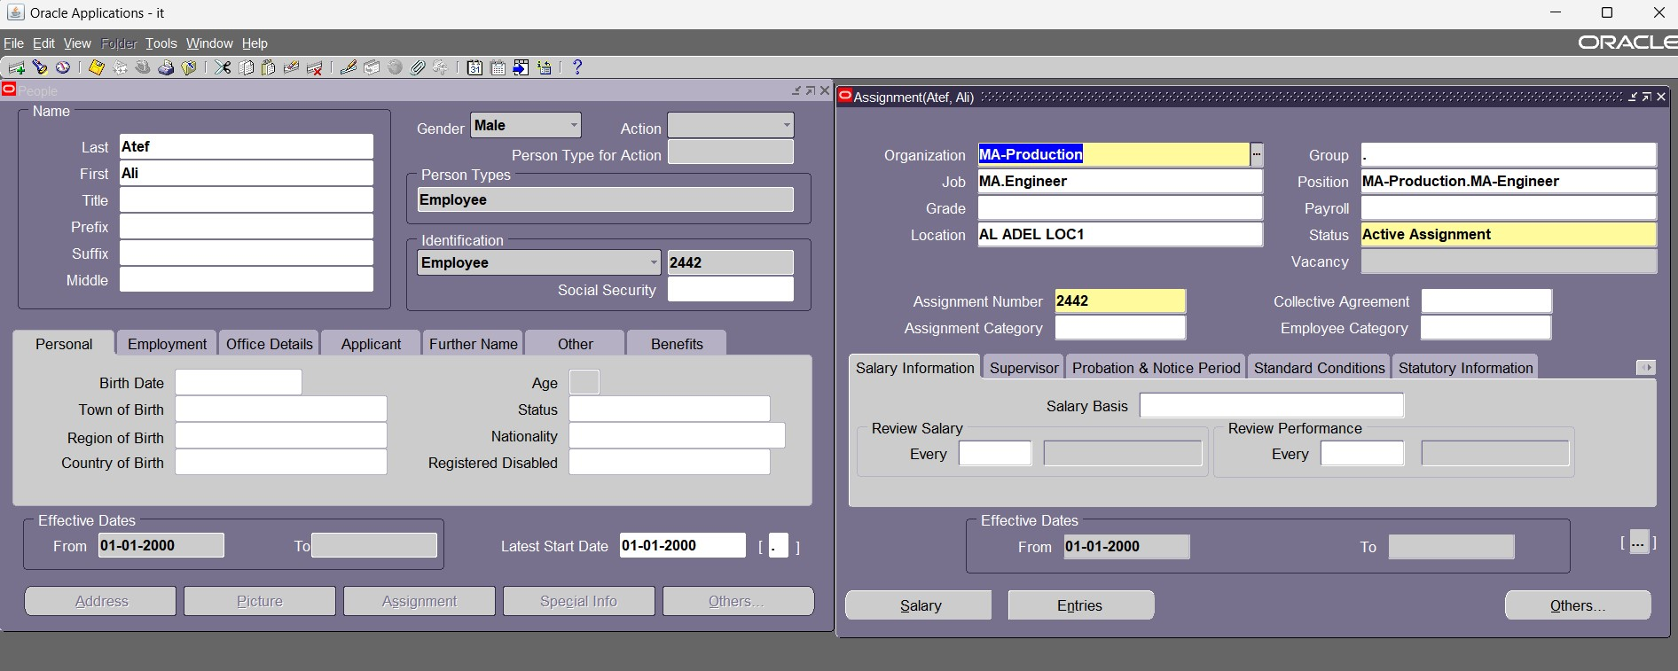
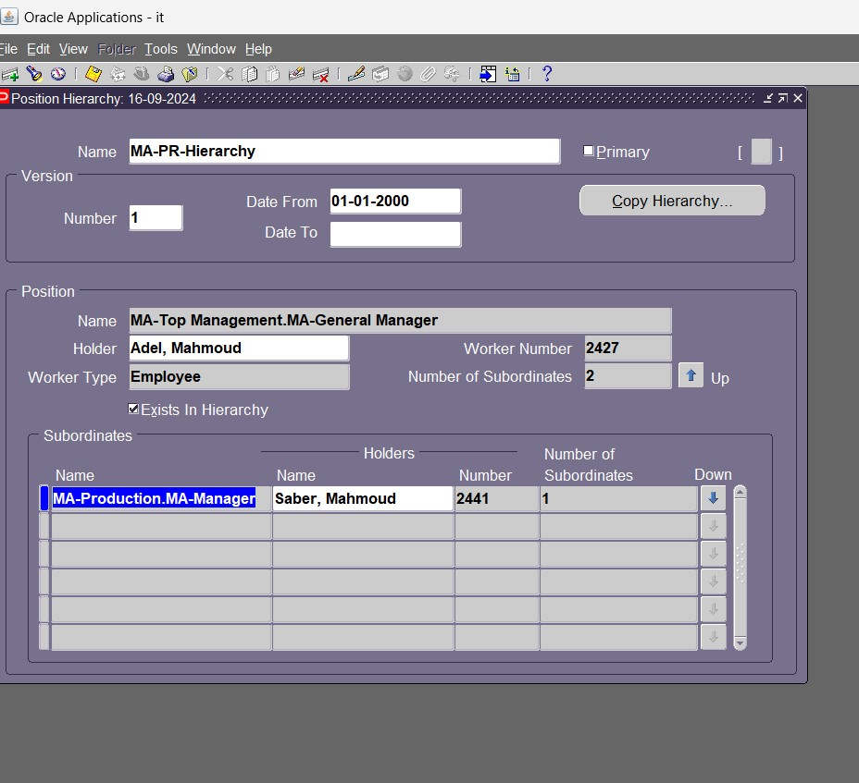

Slide 17
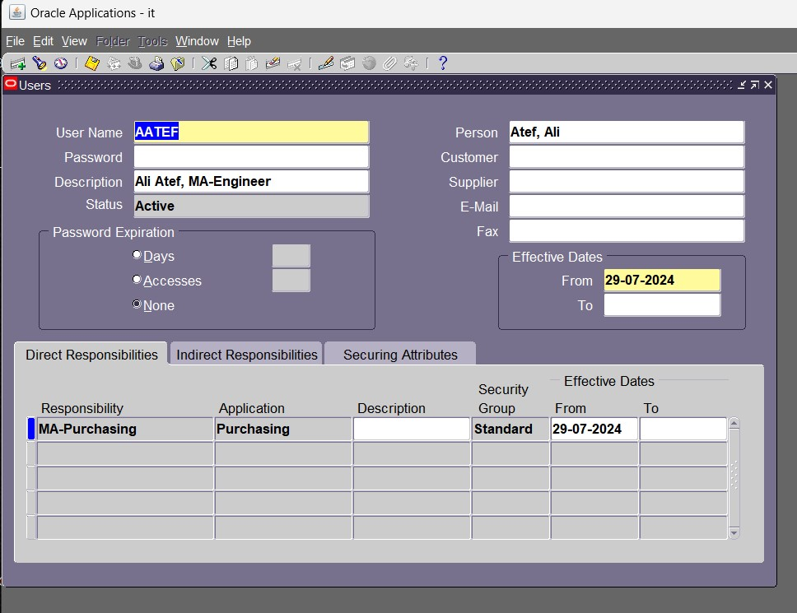
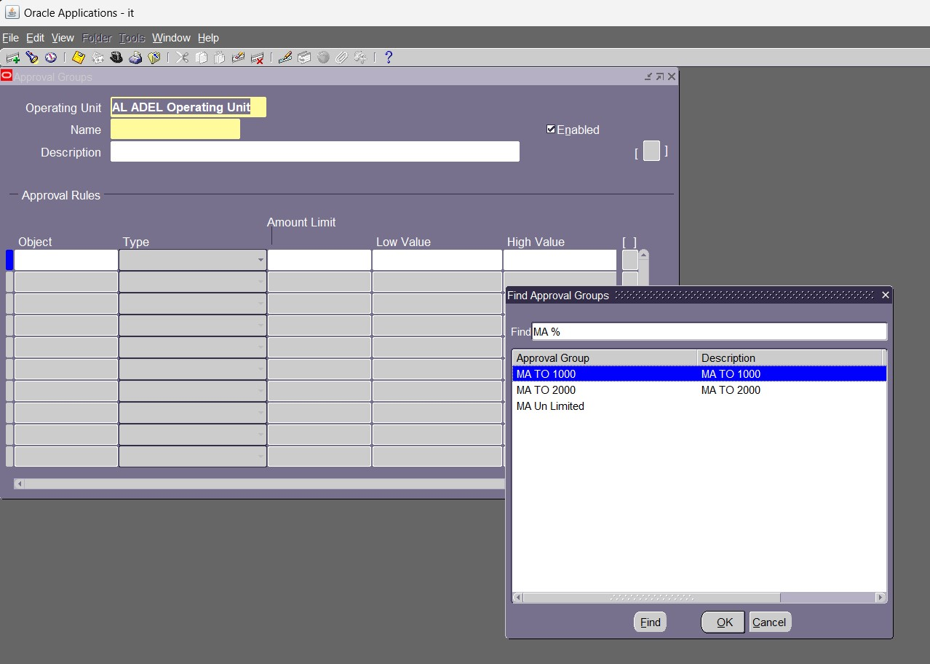

Slide 18
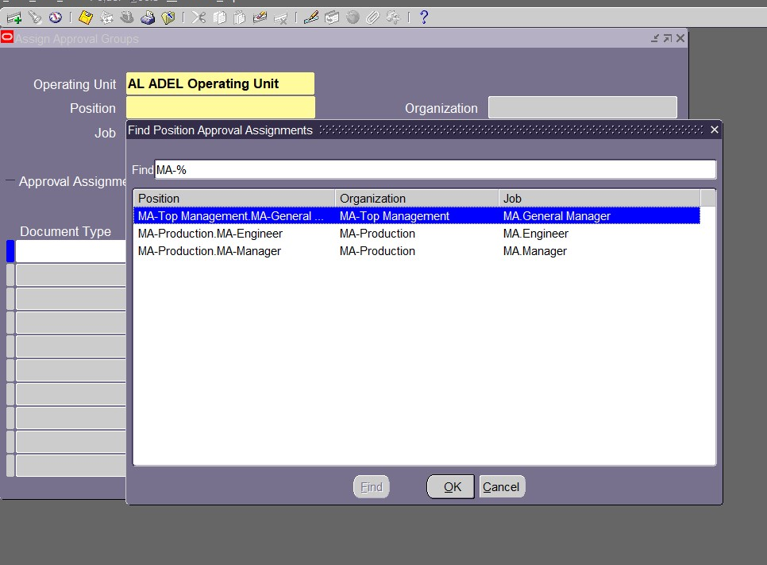
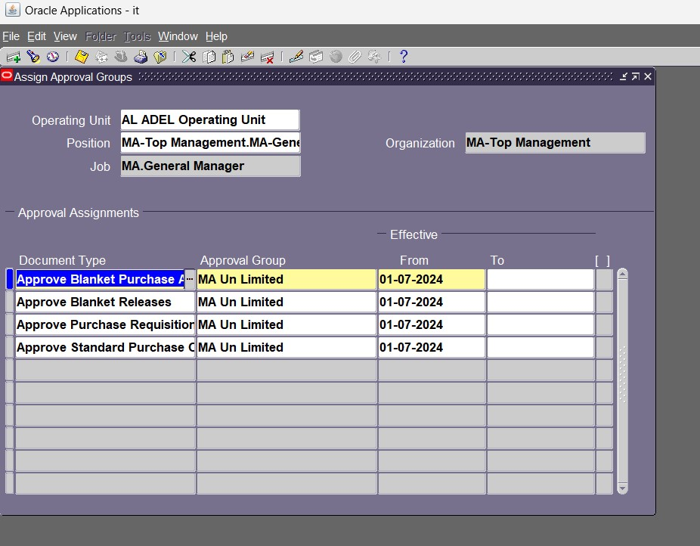

Slide 19
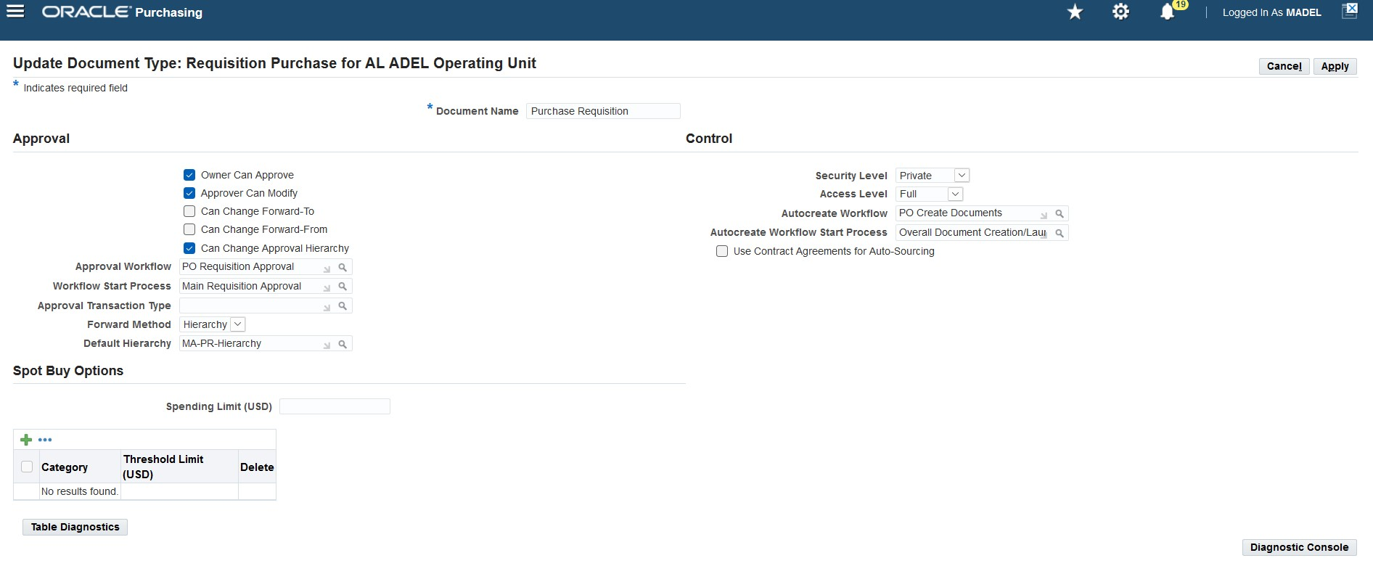
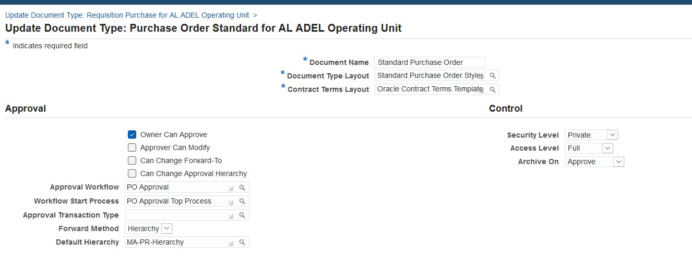

Slide 20
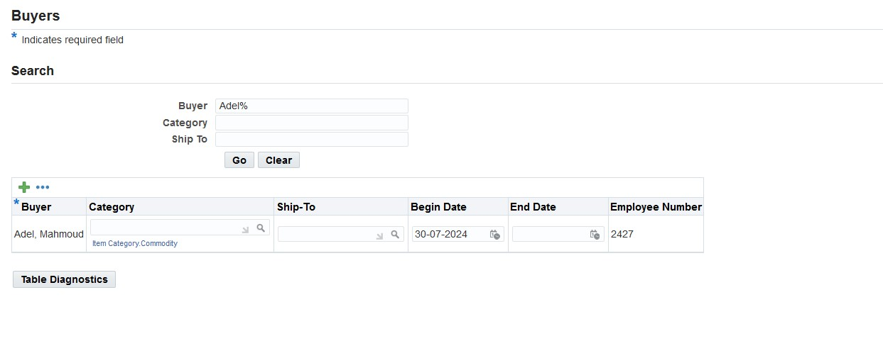
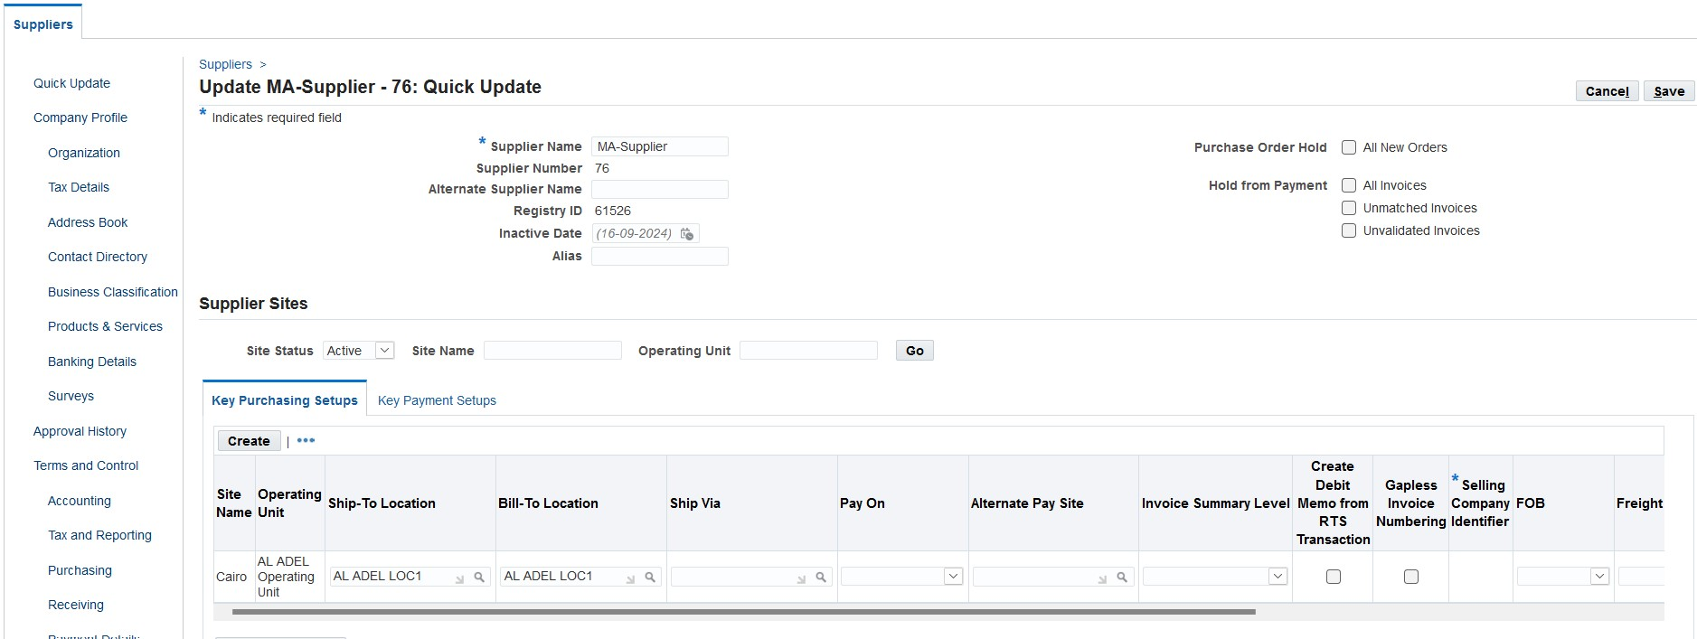

Slide 21
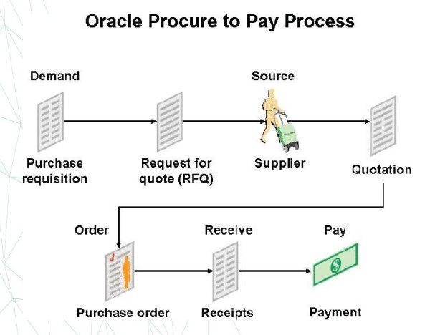

Slide 22
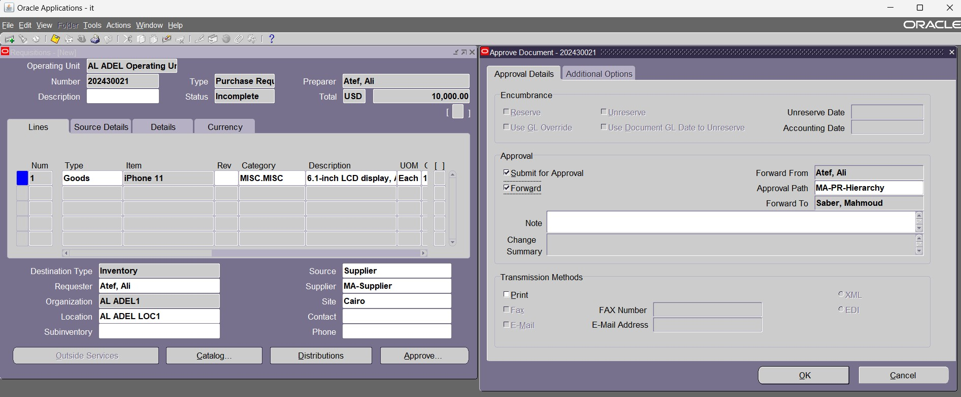
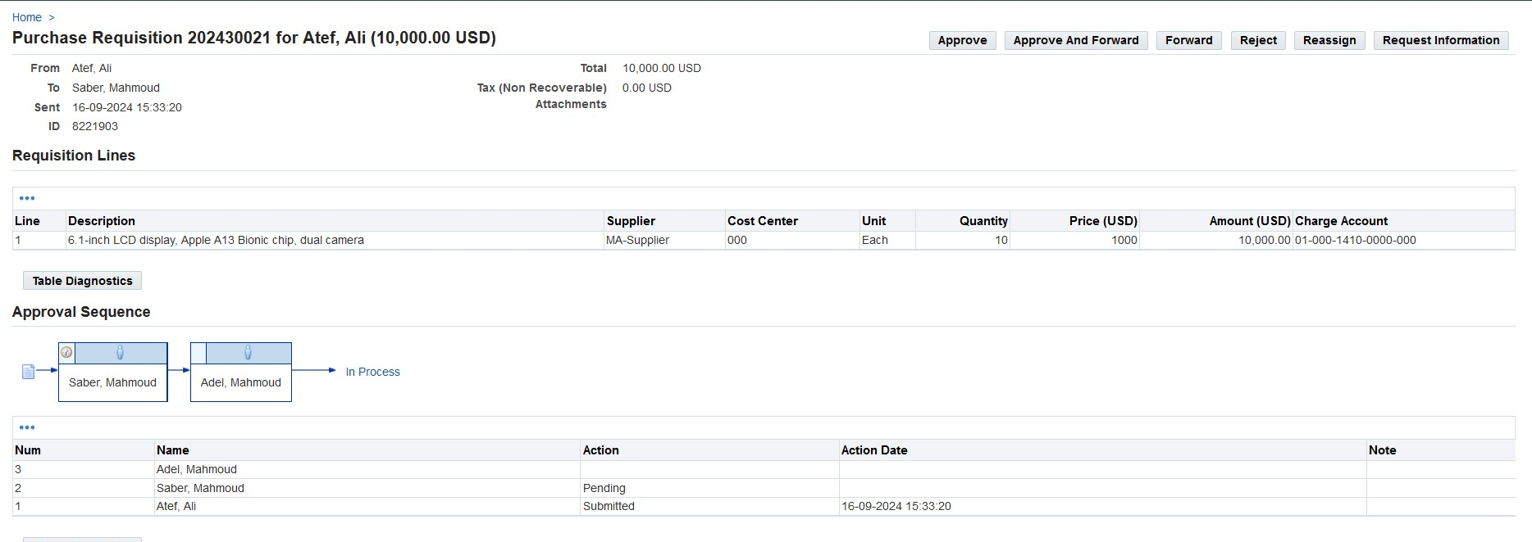

Slide 23
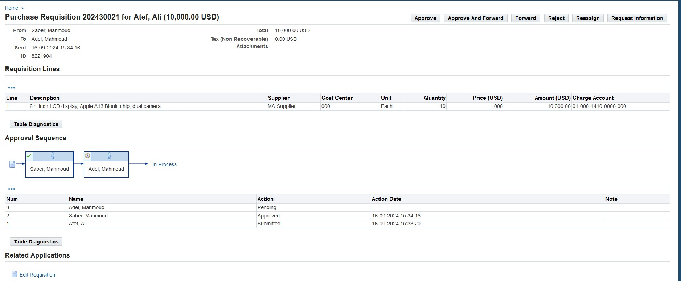
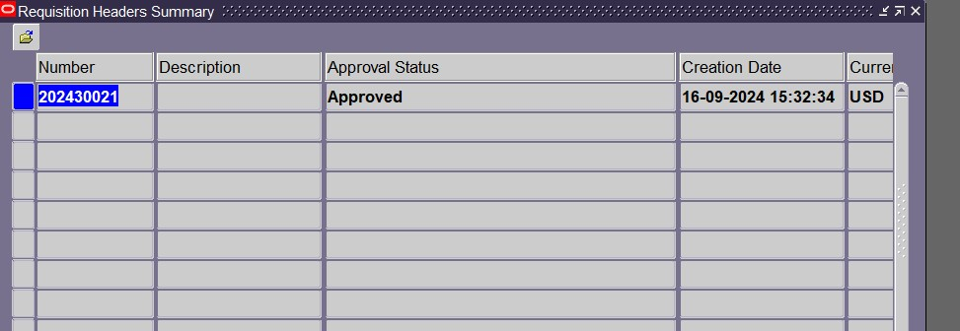

Slide 24
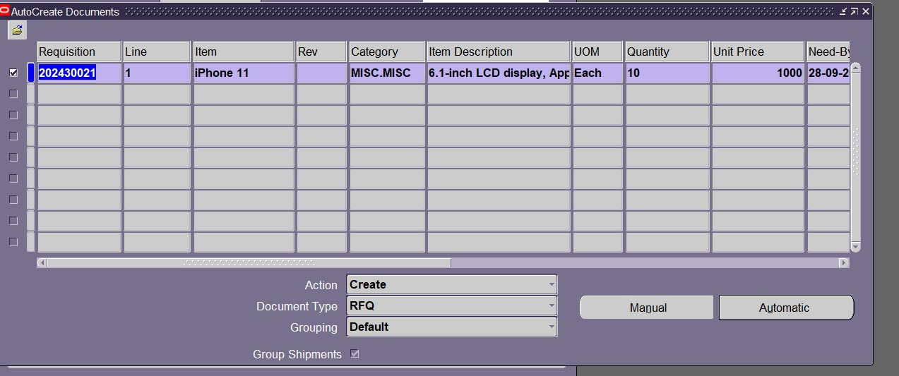
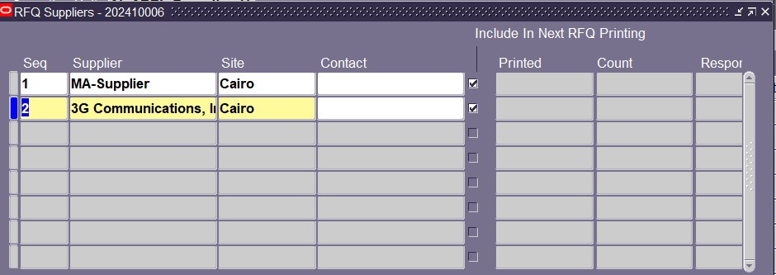

Slide 25
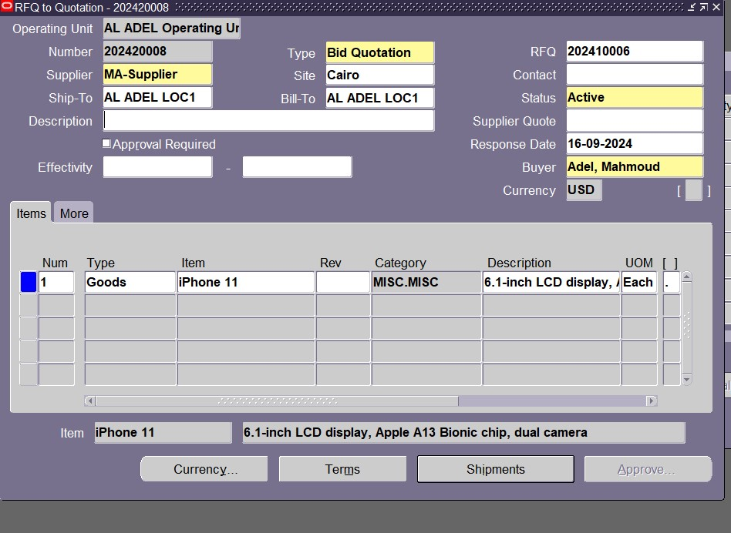
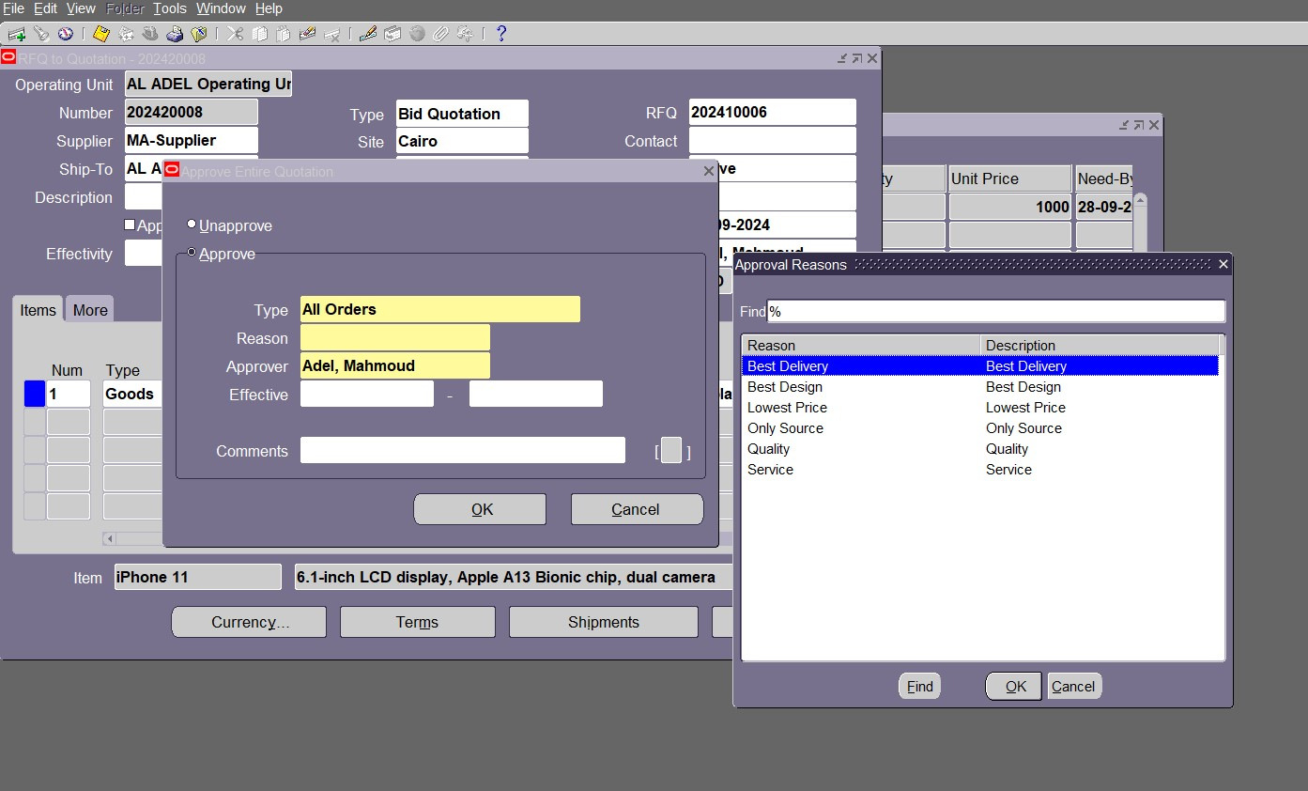

Slide 26
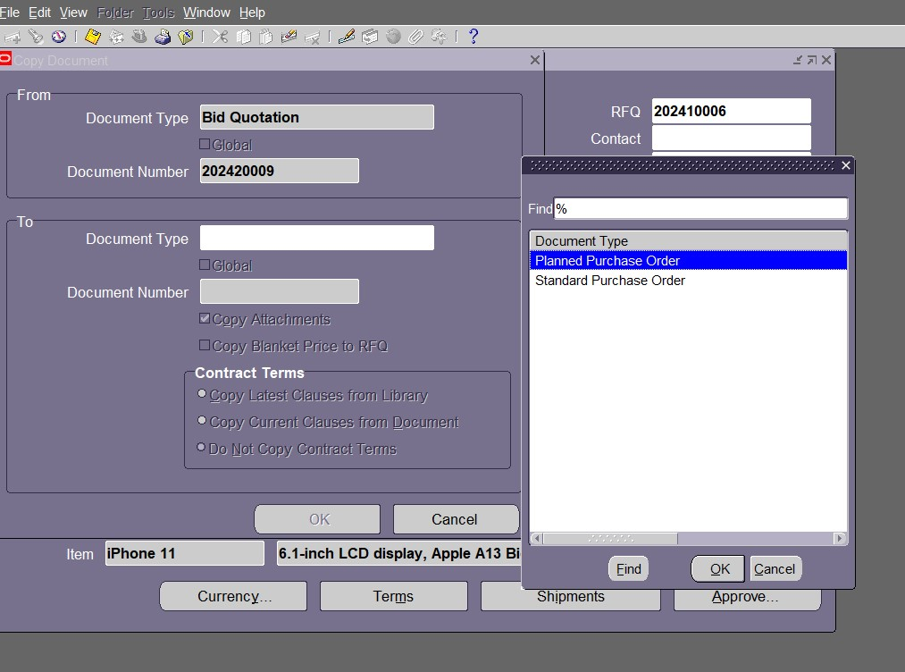
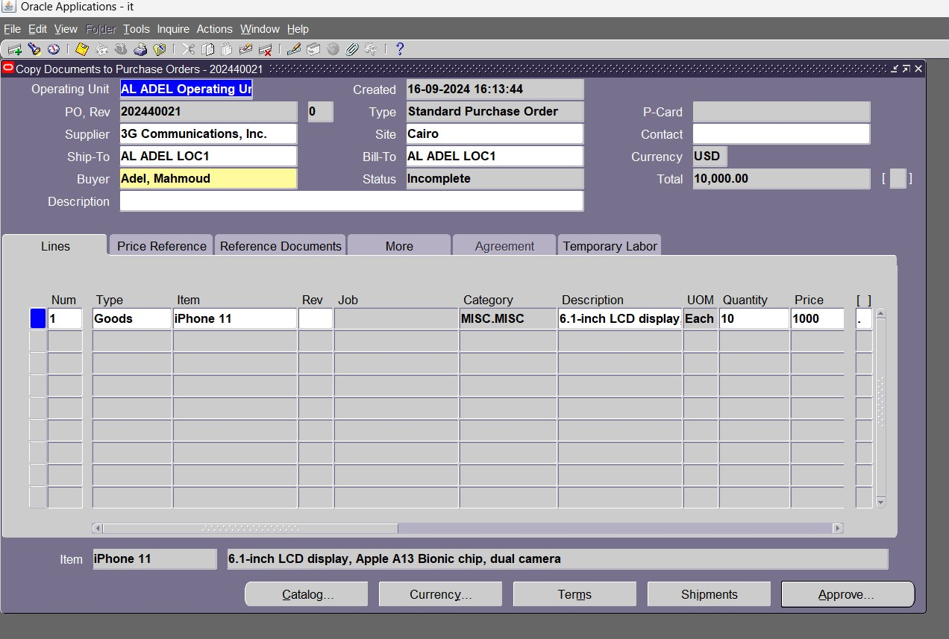

Slide 27
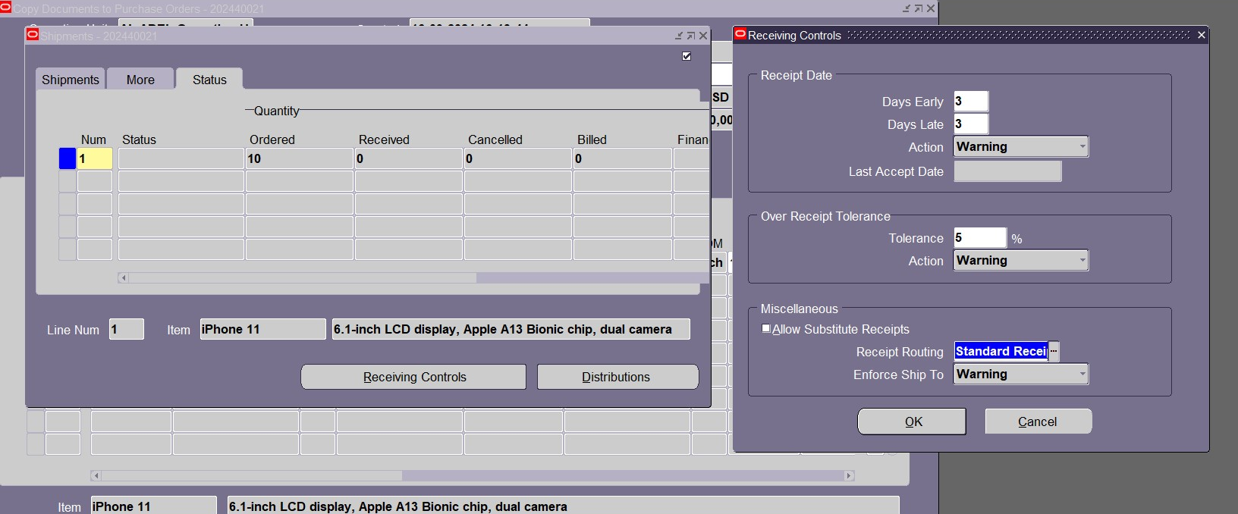
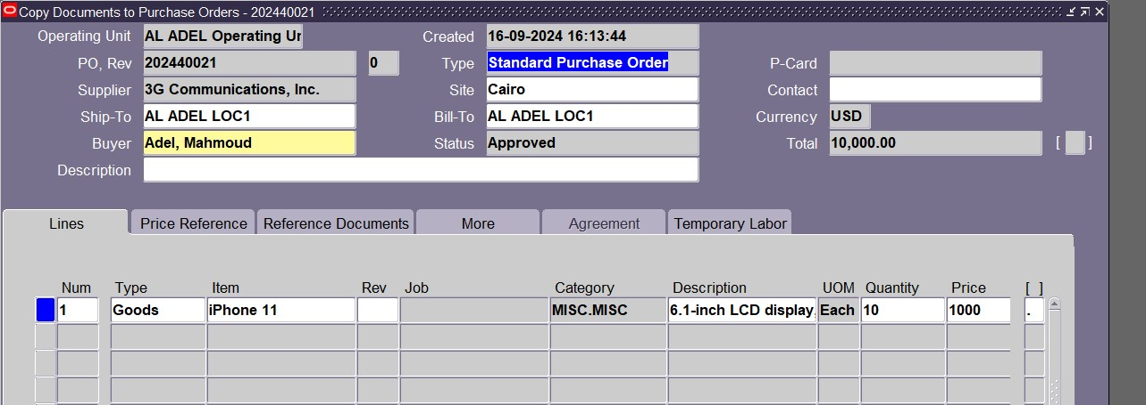

Slide 28
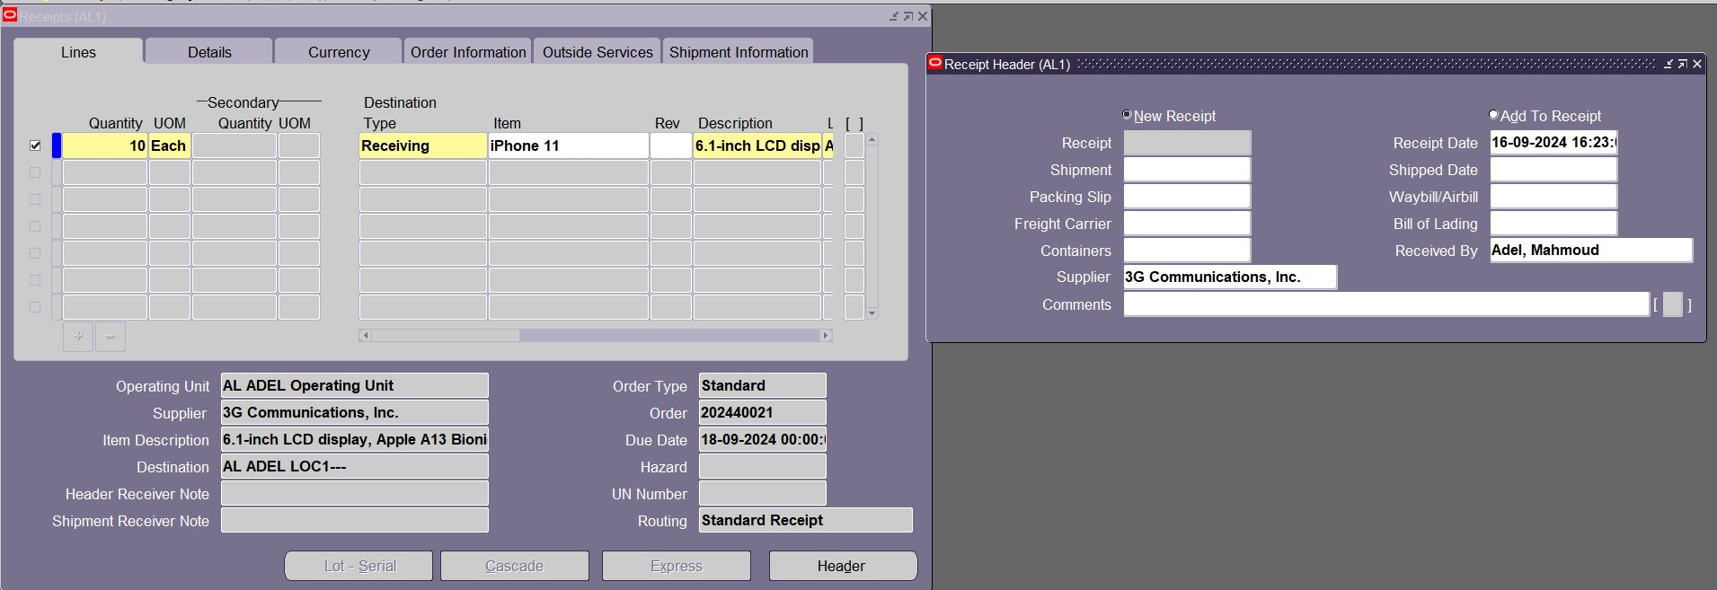
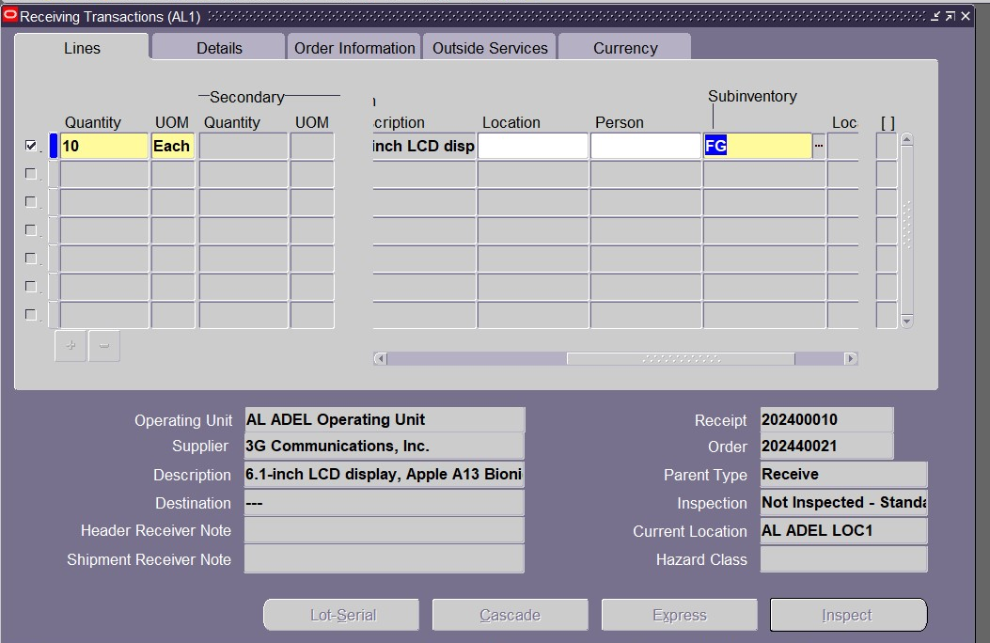

Slide 29
THANK YOU

